Slide 1

Building & Fine-Tuning a Simple AI Chatbot
This presentation outlines the process of building and fine-tuning a simple AI chatbot. I will cover the research, data preparation, implementation, and evaluation phases, highlighting key decisions and outcomes.

Slide 2
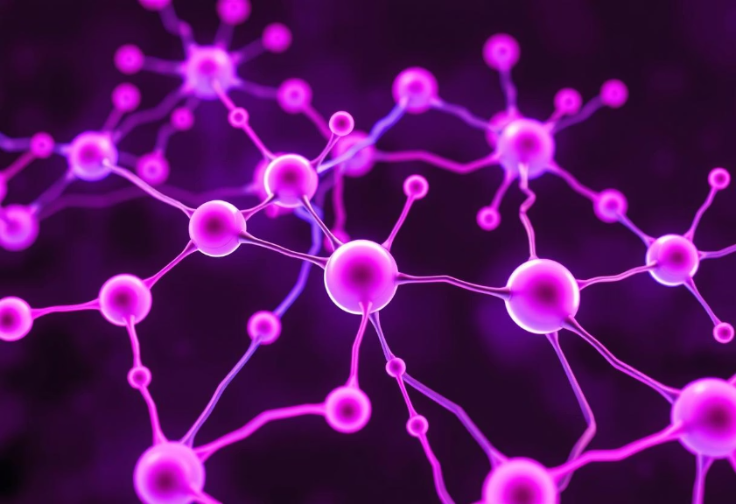
Understanding LLMs and Ethical Considerations
LLM Overview
Large Language Models (LLMs) like GPT-2 generate human-like text by predicting the next word. They are used for chatbots, summarization, and content creation. GPT-2 is an open-source model balancing performance and accessibility.
DialoGPT, a conversationally fine-tuned GPT-2, performs well in open-ended chat but struggles with precision and factual accuracy on small, domain-specific datasets.
Ethical Concerns
Chatbot deployment raises ethical concerns regarding misinformation, privacy, and bias. It's crucial to prevent hallucinations, especially in customer service. Data must be ethically sourced, ensuring privacy and consent.

Slide 3
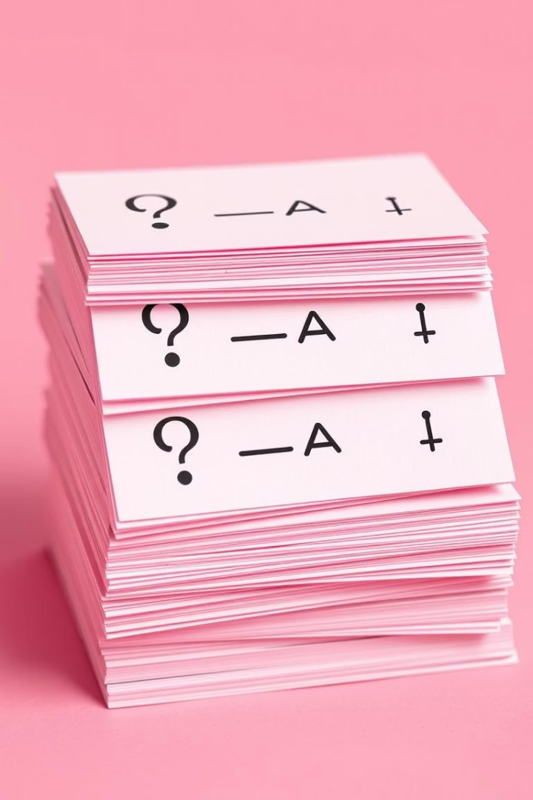
Dataset Justification and Model Selection
Bakery Q&A Dataset
The dataset comprises Q&A pairs about bakery operations: opening hours, product availability, pricing, and services. This makes it ideal for a bakery assistant chatbot.
GPT-2 vs. DialoGPT
GPT-2 was chosen over DialoGPT after experimentation. DialoGPT produced inconsistent and hallucinatory outputs due to overfitting on small datasets. GPT-2 provided more stable and structured responses when trained on formatted prompt-response text.

Slide 4
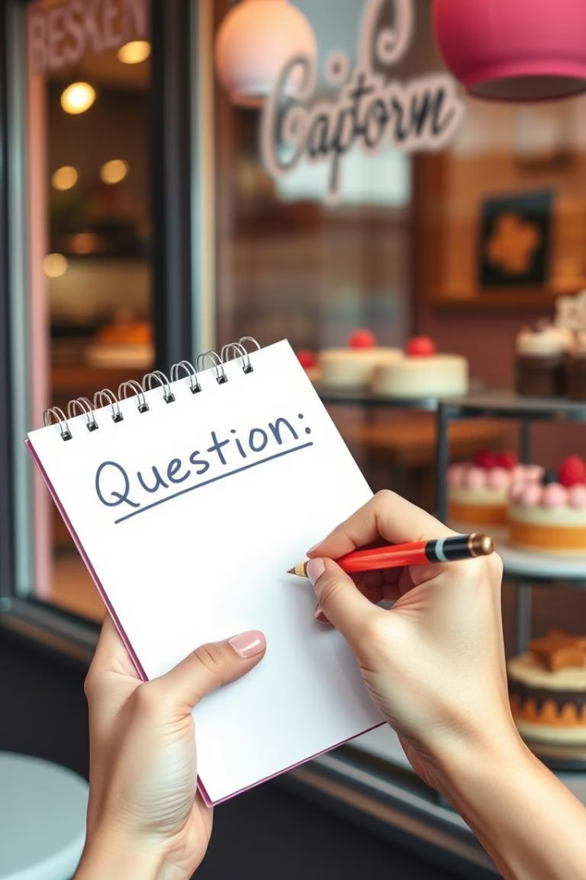



Data Preparation for Fine-Tuning
Manual Curation
The bakery_data.txt dataset was manually curated to ensure quality and relevance.
Prompt-Response Format
Data was structured as "Q: [Question] A: [Answer]" to align with GPT-2's autoregressive training objective.
Clear Q&A Patterns
This format supports clear modeling of question-answer patterns, crucial for accurate chatbot responses.

Slide 5




GPT-2 Fine-Tuning Process
Load Model & Tokenizer
GPT-2 model and tokenizer were loaded using Hugging Face's Transformers library.
Tokenize Dataset
The dataset was tokenized using LineByLineTextDataset, treating each Q&A pair as an independent sample.
Conduct Fine-Tuning
Fine-tuning was performed for 5 epochs with a batch size of 2 and a learning rate of 5e-5.

Slide 6
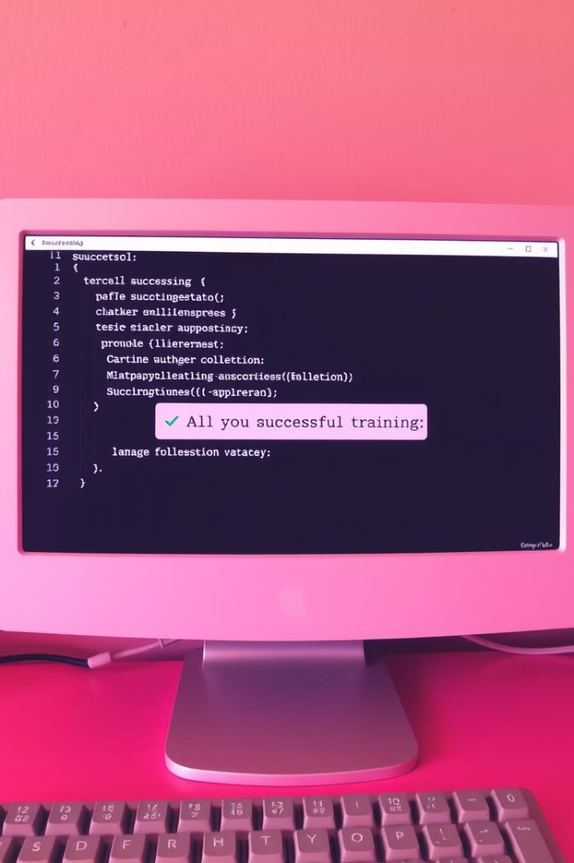



Training Outcome and Model Saving
Reliable Recall
Structured Responses
The fine-tuned GPT-2 model reliably recalled prompt-specific answers, outperforming DialoGPT.
Generated responses were more structured and closely aligned with the training dataset.
Local Storage
The fine-tuned model was saved locally as ./gpt2-bakery for future use and deployment.

Slide 7
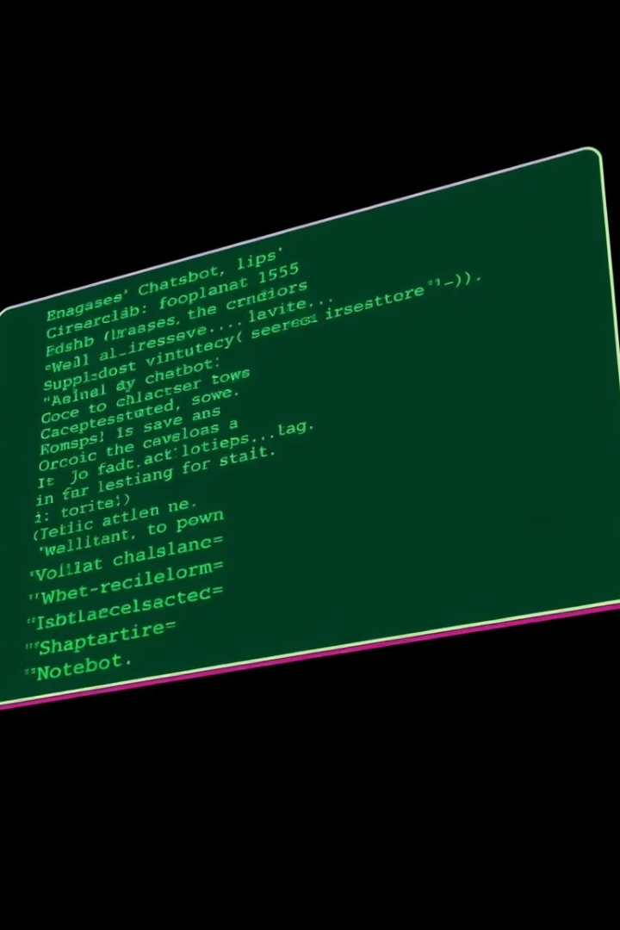
Chatbot Implementation: Command-Line Interface
User Input
The user types a question into the command-line interface.
Model Processing
The input is fed into the fine-tuned GPT-2 model for response generation.
Generated Response
The model generates a response based on learned Q&A patterns, displayed instantly.

Slide 8




Chatbot Functionality and Effectiveness
Consistent Replies
The chatbot provides consistent answers to questions about operating hours, delivery, and product availability.
Pricing Information
It accurately responds to queries regarding pricing for various bakery items.
Real-Time Interaction
The CLI supports real-time interaction, offering instant responses to user queries.

Slide 9
Evaluation and Limitations
Effectiveness
Limitations
GPT-2 significantly outperformed DialoGPT, providing stable and relevant responses. DialoGPT often hallucinated and drifted off-topic due to overfitting on small datasets.
Poor generalization to unseen queries without more diverse data.
Accuracy strictly depends on dataset coverage.
Limited to local inference, not scalable for multi-user environments.

Slide 10






Reflection and Final Justification
Dataset Importance
Highlighted the critical role of dataset quality and format alignment.
Valuable Experience
Gained hands-on experience with fine-tuning and retrieval-based chatbot design.
GPT-2 Chosen
Selected GPT-2 for its predictable and interpretable behavior on structured Q&A data, prioritizing reliability and clarity over conversational flexibility.

